Slide 1
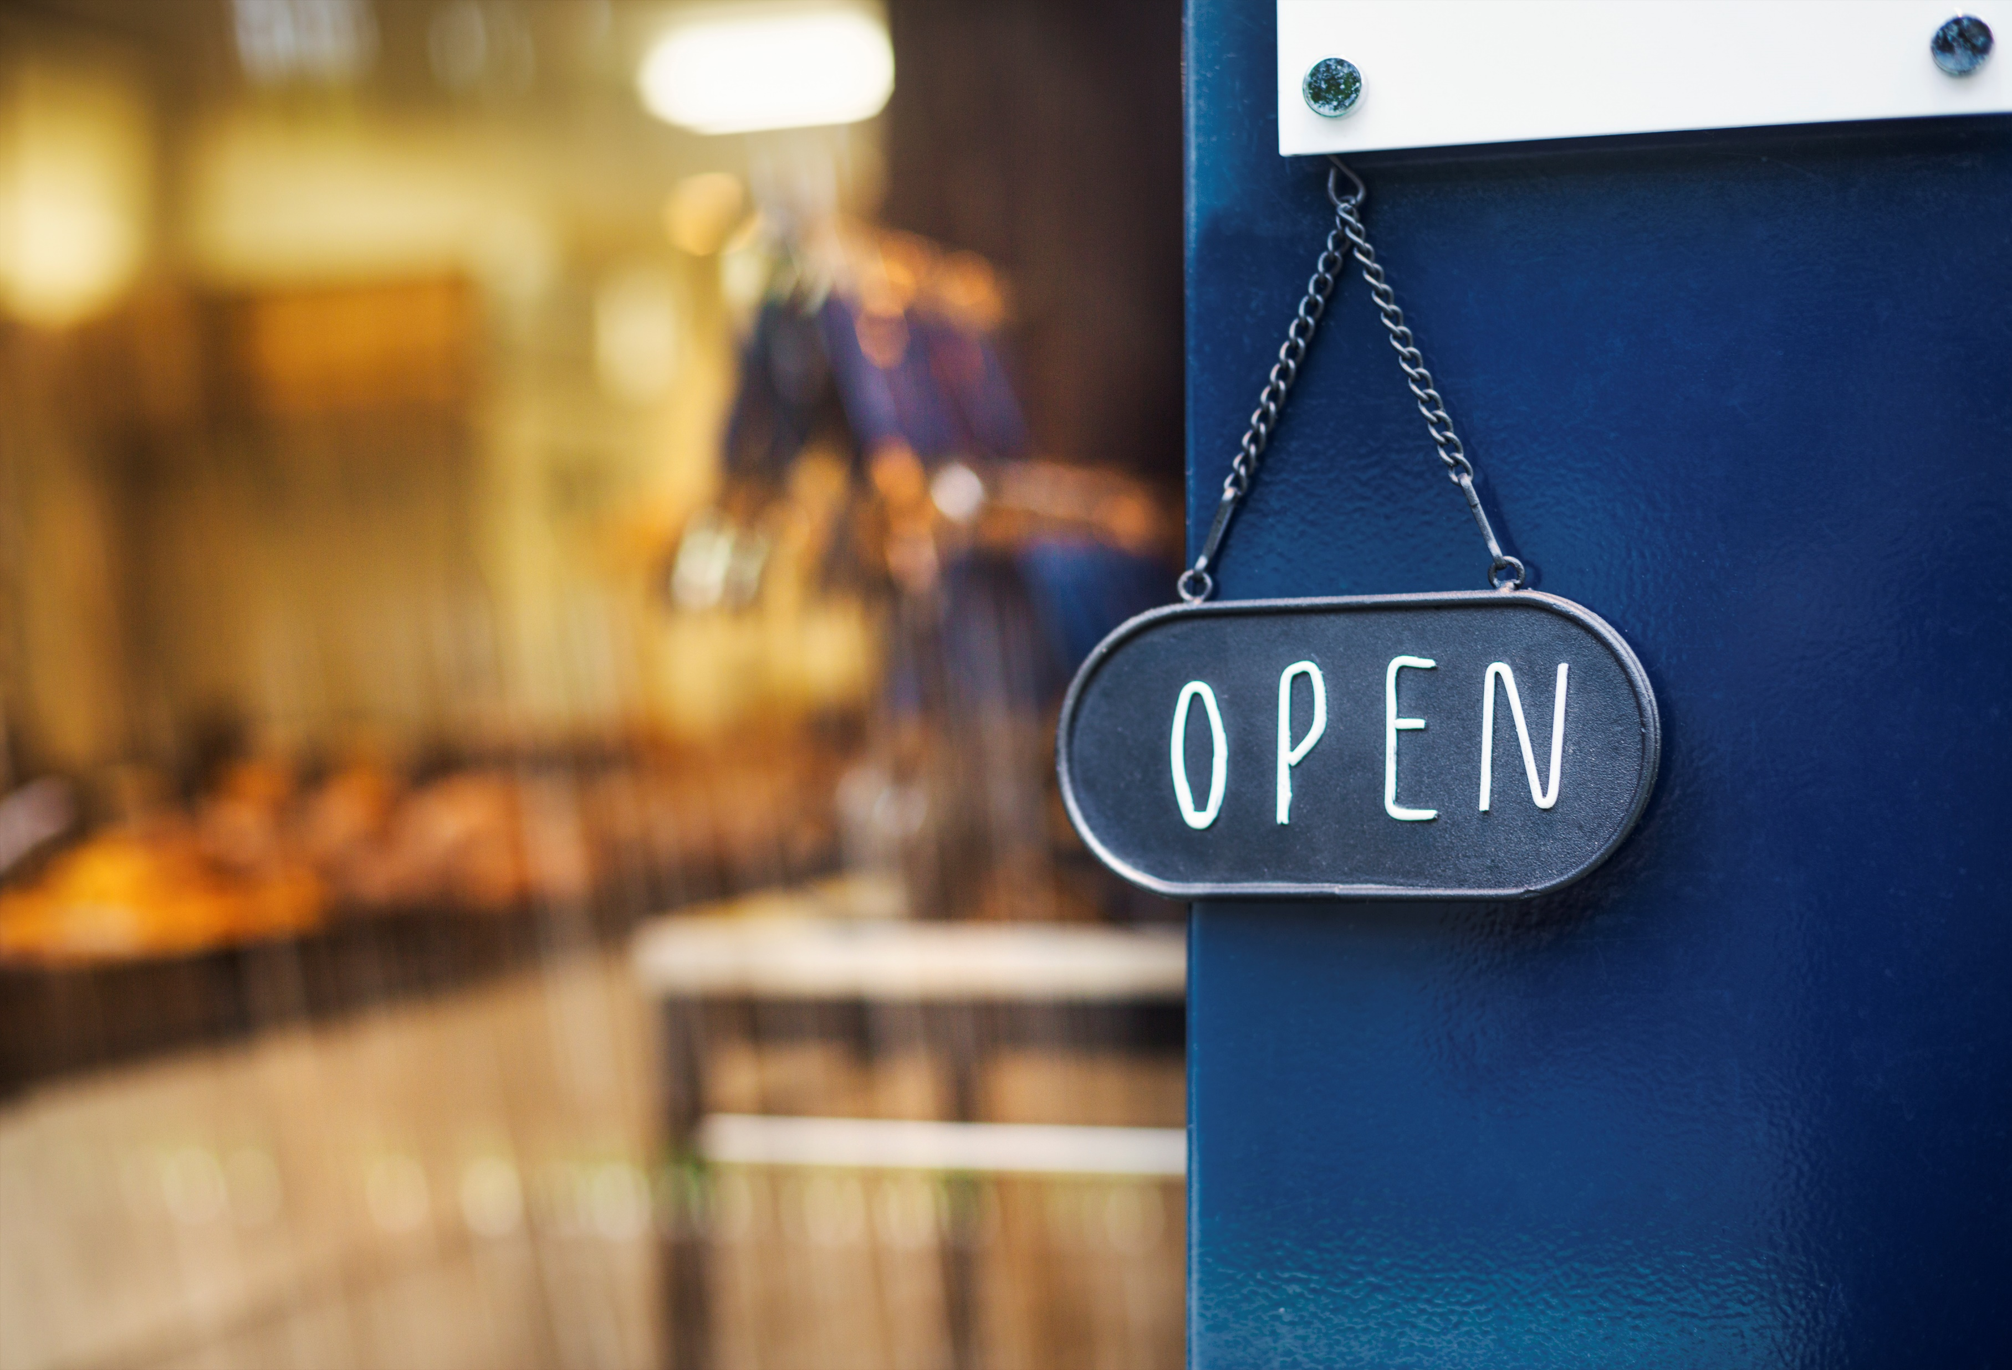
The Municipality of Souris-Glenwood Business & Storefront Improvement Grant
Purpose
To encourage building owners or main floor (storefront) tenants to invest in façade improvements and exterior storefront upgrades.
Now accepting applications!
Eligible businesses can receive up to $2500 in a 1:1 matching grant for façade improvements.
Eligibility
Any existing business located in the Municipality of Souris-Glenwood is eligible to apply. Priority areas have been identified.
Eligible Work
new/additional lighting
high quality pedestrian-scale signage
brick /masonry cosmetic restoration
windows
doors/entrance ways
awnings/canopies
façade cleaning and painting
repair/replacement of cornices, parapets or other exterior architectural features with heritage
accessibility improvements (excluding accessibility ramps)
other improvements as agreed upon by the Municipality of Souris-Glenwood reviewing committee
Important Information
Must apply before work begins
June 30, 2024 Application Deadline
Work must be completed by December 31, 2024
Funds are limited, apply early
Where to Start
Drop by the Municipal Office at 100-2nd St. S, Monday to Friday to pick up your application. You can also find a copy of the application to print at SourisManitoba.com
Contact 204-483-5200 or 204-741-0631
for more information.

